Slide 1
Google – how they manage innovation
Virtually all of the comments set out in this presentation are derived from a reading of ‘How Google Works’ – co-authored by Schmidt, Rosenberg and Eagle but they are set out in a framework for application to your own organization.

Slide 2
What you might discover by viewing this presentation!
What the two founders really wanted to do in setting up Google
How innovation is managed at Google. It is managed!
- Organization arrangements
- Google’s policies and management practices which encourage innovativeness
- Strategic planning and its purpose
- Is innovation working?
The early development of a model for the management of innovation which could be applied to your own organization

Slide 3
Quick summary of what makes for innovation management at Google.
Old management ideas but brought up to date – even futuristic in their application
Extreme openness and transparency
Optimal use of new technologies
Communications facilitated by technology
Pasteur’s model at the center or Google thinking
Very different than most corporations
For further reference, go to; http://www.corporateinnovationonline.com or just search ‘CIOMAX’

Slide 4
Founders’ vision for Google
Perhaps President Obama had it right when talking to Pope Francis when he said “
Set out to establish a company which was to be similar to a university
Google works because of a combination of; strategy, culture and hiring excellence
Hire the ‘smart creative’ and problems will be solved; allows an individual and corporate bias for action
Culture is the ‘rails’ of the organization and its ‘basis for everything’
The company was not about ‘maximizing the short-term value and marketability of their stock’
Invoking ‘Pasteur’s Model’ says a lot about where they want to work

Slide 5
Organization @ Google
Applying the ‘rule of seven’ – to avoid micromanagement
A flat organization – facilitated by communications via technology
Functional organization – to avoid the creation of ‘silos’
Physical (office layout) arrangements – to create crowding and its benefits
Product/sevice people have a prominent role in presentations and decision making
Relationships not hierarchy are the focus
Use of OKR’s – management by objectives under a different guise

Slide 6
Strategy @ Google
Platforms; not products or services, are the focus of strategic planning
Strategy presentations, at all levels including with the Board, are made by those who have a full knowledge of the inner workings of products and services – not some ‘management type’
Investment allocations are 70% for core products, 20% for emerging products, and 10% for the ‘unknown’
Somewhat limited use of financial projections – more emphasis on ‘faith’
No market research nor channel strategies
Strategic plans are employed to reinforce organizational alignment

Slide 7
Board & senior management arrangements @ Google
Holding meetings at frequent intervals – to avoid repetition and at the same time instill a sense of urgency
Quarterly reviews for presentation to the Board and the dissemination of the plan update to all of Google
Meetings dominated by two questions;
- What is the technical insight upon which new features will be built?
- Data, and its use, not by ‘management types’ but by those who know the product/service intimately.
A bias for action – ‘smart creative’ will solve the problems as they arise

Slide 8
Is Google’s approach to the management of innovation working?
W&P follows five highly-innovative companies; Starbucks, Deere & Co., GE, 3M and P&G. By comparison with these five companies Google’s annual average return on capital (since 2006) compares unfavorably with 3M, Deere & Co. and Starbucks.
Of all of the companies which we have researched, 3M is our pick for a company having the best policies and management practices encouraging innovation. 3M has also been around a lot longer and passed through several generations of management!

Slide 9
Is Google’ approach to the management of innovation working?
Revenue growth rate has slowed since 2012 but the ‘market’ still remains optimistic – at least for now.

Slide 10
Is Google’ approach to the management of innovation working?
Relative increases since 2006 shows that while revenue has increased significantly – influenced by acquisitions – earnings per share and particularly the stock price have lagged expectations.
Just recently (December, 2014) it has been reported that Larry Page has stepped back from day-to-day management stating that he was frustrated with the pace of innovation.

Slide 11
Google’s contribution to a ‘model for the management of innovation’
Google’s approach to the management of innovation has contributed to the development of our model.
For a company to be successful it should have a set of policies and management practices which encourage innovation.
While the roles of senior management and the Board are important, it is the CEO who sets the tone and call the shots.
Effective management of innovation
Financial and human resource management
Financial performance
Growth
Profit
Stock price
Earnings
P/E ratio
Reliable products/services
Culture
Communications; intra-company
Technology investment
Strategy/organization

Slide 12
A MODEL FOR THE SUCCESSFUL MANAGEMENT OF INNOVATION
Six essential components
A generic model based on researching management practices of highly-innovative companies

Slide 13
Your input to the model?
Corporate Innovation Online
Benchmarking innovation
Building and sustaining innovation
Articulating innovation
White & Partners, with a view to sharing successful policies and management practices with interested readers, is in the process of developing a generic model for the management of innovation.
Which policies and management practices are common to highly-innovative companies? We share our results to date. Send your comments to pcwhite@corporateinnovationonline.com.

Slide 14
Booz&co. The 2013 Global Innovation Study
Booz&co. latest report makes an insightful observation about innovation.
  For the ninth year in a row, we have found no correlation between how much companies spend on R&D and their financial performance.
  How companies spend their innovation dollars is much more important. Our studies have consistently shown that innovation investments in select capabilities, tools, talent, and culture which are tightly aligned with a business’s strategy are what drive sustained success.
These comments lead directly into our desire to develop a model for managing innovation, not based on any single-factor but based on multiple factors. But which factors are the most important? There is no silver bullet!

Slide 15
Effective management of innovation
Culture
Financial and human resource management
Financial performance
Growth
Profit
Stock price
Earnings
P/E ratio
Strategy
Our model is based on the hypothesis that effective management of innovation gives rise to better-than-average financial performance over the long term. In turn, innovation brings results in increased earnings and ultimately an increase in stock price, albeit impacted by the whims and vagaries of the market as a whole and the overall economy. The simplicity of the model belies the difficulty of doing it!

Slide 16
Six essential components for the successful management of innovation
We have researched a ‘basket’ of highly-innovative companies and found that there are specific characteristics – policies and management practices common to most - which lead to innovation.
Our ‘basket’ includes; Starbucks, Deere & Co., GE, P&G and 3M.
On the assumption that one learns more from mistakes than successes, we have also researched; RIM (now Blackberry), Massey-Ferguson, and HP, amongst others.
1. Performance management
2. Communication
3. Reliability
4. Technology development
5. Culture
6. Strategy and organization

Slide 17
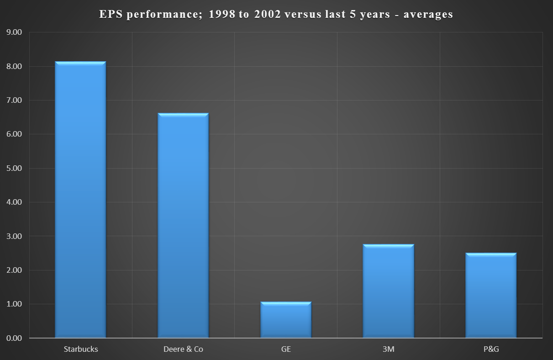
Research into a diverse ‘basket’ of companies
Diversified companies such as GE, 3M, and P&G along with more focussed organizations like Deere and Starbucks
For data behind the two charts please go to http://www.corporateinnovationonline.com

Slide 18
1. Performance management
Strong financial performance provides the company with a sense that its financial house is in order and that investment decisions, while satisfying clearly-stated and understood criteria, will be seriously considered for investment.
A system of managing human resources which aligns individuals with the corporate goals, measures individual and group performance, and provides fully transparent team-based rewards throughout the organization.

Slide 19
2. Communication
A focus on regular communication of corporate policies and management practices, appointments and matters impacting individuals and groups within the organization. Making people constantly aware of new developments in the ‘how’ of management.
A company which values broadly-based input into decision making and values speed but not over careful evaluation of opportunities and risks.
Cohesion and a commonly-held vision of the future is facilitated by meetings/gatherings of senior managers at key points in the development of the company.

Slide 20
3. Reliability
Delivering what the company says it will deliver to customers thus building a sense of trust between company and customer.
The delivery of reliable products – products which perform under all likely situations.

Slide 21
4. Technology development
A consistency in the company’s spending and approach to spending on R&D. People like to work for an organization which has a reputation for its ideas, its innovations. Spending is an indicator of this commitment.
Maintaining a watch on developments at the customer level and overall end-user and carefully noting the demographic and economic shifts which eventually impact product/service demand.
Continually monitoring competitor developments and understanding the competitive situation globally.
Investing in new products/services and less so in ‘legacy’ products.

Slide 22
5. Culture
Attributes of culture
Of the companies in our ‘basket’, 3M is, when it comes to the management of innovation, outstanding and because of the practise noted below.
Tight centralized financial management with maximum decentralization and looseness throughout the organization.
A healthy regard to the impact of culture on acquisition practices – making culture an element of the criteria for any potential acquisition.
A healthy respect for traditions and even folklore.

Slide 23
6. Strategy and organization
Ensuring that industry knowledge and its complexity are well understood by a percentage of the Board of directors. The term ‘adaptive Board’ is relevant.
Suitable succession planning – a Board responsibility.
Continuity and longevity of senior management.
A Board and CEO perspective on both the short and long-term; achieving a balance in major decision making.
Making acquisitions which are essential to technology or market growth but where culture is an important part of the evaluation process.
At ease with adapting ideas from outside the organization through acquisitions or through mid-career hires.

Slide 24
Companies reviewed most recently
CIOMAX reports; provide insight into management of innovation and information for investors
  Starbucks
  P&G
  GE
  DSM
  Deere & Co.
http://www.corporateinnovationonline.com
Massey-Ferguson Ltd.
Glencore (Xstrata)
HP
Koch Industries Ltd.
Blackberry (when it was RIM)
Apple versus RIM

Slide 25
End

