Slide 1
How 3M manages innovation
3M is recognized as one of the world’s most admired and innovative companies.
This PPTX presentation draws on CIO’s research into the policies and management practices which have been in place at 3M for over 100 years. Our full research is available on the web site; http://www.corporateinnovationonline.com

Slide 2
What you will discover by viewing this presentation!
How 3M’s founders set the tone for years to come and next generation managers kept the faith.
Insight into how innovation is managed at 3M. - What specifically is great about 3M’s approach to managing innovation. - 3M’s policies and management practices which encourage innovativeness.
The early development of a model for the management of innovation which could be applied to your own organization

Slide 3
A quick summary of the characteristics of innovation management at 3M.
Decentralization and limited hierarchy
Focussing and measuring the importance of new products/services with the use of 3M’s NPVI
R&D investment; consistent over decades despite economic cycles
Rewards and recognition of innovators in place, emphasized and communicated
A core value that 3M is an innovative company
3M is open and transparent about its innovation strategy, management and results

Slide 4
Founders’ vision for 3M
The dominant influence of McKnight is obvious and, as with many innovative companies, the founder or founders need to be given credit for getting the culture in place from the start. McKnight had 60 years to influence 3M’s culture. Subsequent CEOs have kept on the same path.
From 2001 until 2012 3M was, for the first time in its history, led by two ‘outsiders’; leadership bought in by the Board and appointed without either appointee having any prior 3M experience. Mixed results?
The founders’ vision has been further developed under successive CEOs and senior management including the most recent three CEOs; McNerney, Buckley, and mort recently with the appointment of an ‘insider’, Thulin.

Slide 5
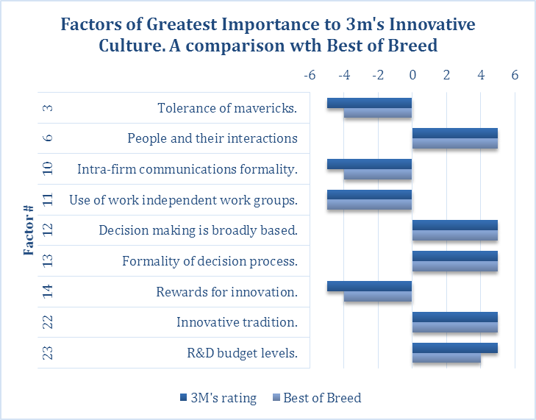
Nine practices set 3M apart from many other companies
For four of the nine Factors impacting innovation, 3M exceeds our Best of Breed!
Innovation results from not one single Factor but rather from a combination of practices.
For definition of ‘Factors’ visit the web site.

Slide 6
Strategy, policies, climate and culture are all in place at 3M
Strategy is the science and art of using the resources of the business to execute approved plans as effectively as possible.
Management practices is to do, or perform habitually, customarily, in order to acquire or polish a skill.
Policies; a plan or course of action, as in a business, and intended to influence and determine decisions and actions.
Innovation climate and culture; a prevailing condition or set of attitudes in human affairs; behavior patterns and beliefs.
3M identifies ‘platforms’ as the term for its allocation of investment.
14 science/technology platforms make up 3M’s portfolio.

Slide 7
Board & senior management challenges at 3M
Perhaps the most important of these efforts is the rekindling of the innovative spirit at the company. If it were possible to show you literally, you would see a figurative forest fire of innovation taking place all across the company. We’ve not seen anything like this since the 1970s and it is utterly marvelous to see. While everyone in the company, whether in sales, marketing, manufacturing, procurement and administration has played a vital role in driving this, 3M’s scientists, process engineers and innovators still remain the single most important competitive advantage we have, everywhere in the world. They are the engine room of our progress, and the collective imagination of our creative people is ultimately the birthplace of our success. This vital and core part of our culture is what we need to protect and foster into the future. So long as we drive this creativity and at the same time continue to run our manufacturing operations at world-class levels, we have relatively few things to fear.
George Buckley 2012.

Slide 8
Is 3M’s approach to the management of innovation working?
3M’s financial performance, in terms of return on total capital, over the recent period is better than the other two highly-diversified companies, GE and P&G, which CIO has researched. The other two companies in this group, Deere & Co. and Starbucks have great performance but are not nearly as highly diversified as is 3M.
Of the companies which CIO has researched, 3M is the pick for a company having the best policies and management practices encouraging innovation. 3M has also been around a lot longer and passed through several generations of management!

Slide 9
3M’s contribution to a ‘generic model for the management of innovation’
For a company to be successful it should have in place a set of policies and management practices which encourage innovation.
While the roles of senior management and the Board are important, it is the CEO who sets the tone and calls the shots.
Effective management of innovation
Financial and human resource management
Financial performance
Growth
Profit
Stock price
Earnings
P/E ratio
Reliable products/services
Culture
Communications; intra-company
Technology investment
Strategy/organization

Slide 10
A MODEL FOR THE SUCCESSFUL MANAGEMENT OF INNOVATION Six essential components
A generic model based on researching the management practices of highly-innovative, idea-intensive companies

Slide 11
Your input to the model?
CIO, with a view to sharing successful policies and management practices with interested readers, is in the process of developing a generic model for the management of innovation.
What are the policies and management practices common to highly-innovative companies? Send your comments to pcwhite@corporateinnovationonline.com.

Slide 12
Booz&co. The 2013 Global Innovation Study
Booz&co. seminal report makes an insightful observation about innovation.
For the ninth year in a row, we have found no correlation between how much companies spend on R&D and their financial performance.
How companies spend their innovation dollars is much more important. Our studies have consistently shown that innovation investments in select capabilities, tools, talent, and culture which are tightly aligned with a business’s strategy are what drive sustained success.
These comments lead directly to CIO’s desire to develop a model for managing innovation. But which factors are the most important? There is no silver bullet!

Slide 13
Effective management of innovation
Culture
Financial and human resource management
Financial performance
Growth
Profit
Stock price
Earnings
P/E ratio
Strategy
CIO’s model is based on the hypothesis that effective management of innovation gives rise to better-than-average financial performance over the long term. In turn, innovation brings results in increased earnings and ultimately an increase in stock price, albeit impacted by the whims and vagaries of the market as a whole and the overall economy. The simplicity of the model belies the difficulty of doing it!

Slide 14
Six essential components for the successful management of innovation
CIO has researched a ‘basket’ of highly-innovative companies and found that there are specific characteristics – policies and management practices common to most - which lead to innovation.
CIO’s ‘basket’ includes; Starbucks, Deere & Co., GE, P&G and 3M and buttressed by research into 30 other companies.
On the assumption that one learns more from mistakes than successes, CIO has also researched; RIM (now Blackberry), Massey-Ferguson, and HP, amongst others.
1. Performance management
2. Communication
3. Reliability
4. Technology development
5. Culture
6. Strategy and organization

Slide 15
1. Performance management
Strong financial performance provides the company’s stakeholders with a sense that its financial house is in order and that investment decisions, while satisfying clearly-stated and understood criteria, will be seriously considered for investment.
A system of managing human resources which aligns individuals with the corporate goals, measures individual and group performance, and provides fully transparent team-based rewards throughout the organization. Note comment from Booz&co!

Slide 16
2. Communication
A focus on regular communication of corporate policies and management practices, appointments and matters impacting individuals and groups within the organization. Making people constantly aware of new developments in the ‘how’ of management.
A company which values broadly-based input into decision making and values speed but not over the careful evaluation of opportunities and risks.
Cohesion and a commonly-held vision of the future is facilitated by meetings/gatherings of senior managers at key points in the development of the company.

Slide 17
3. Reliability
Delivering what the company says it will deliver to customers thus building a sense of trust between company and customer.
The delivery of reliable products – products which perform under all likely situations.

Slide 18
4. Technology development
A consistency in the company’s spending and approach to spending on R&D. People like to work for an organization which has a reputation for its ideas and its innovations. Spending is an indicator of this commitment.
Maintaining a watch on developments at the customer level and overall end-user and carefully noting the demographic and economic shifts which eventually impact product/service demand.
Continually monitoring competitor developments and understanding the competitive situation globally.
Investing in new products/services and less so in ‘legacy’ products.

Slide 19
5. Culture
Attributes of culture
Of the companies in CIO’s ‘basket’, 3M is, when it comes to the management of innovation, outstanding and it is because of the practise noted below.
Tight centralized financial management with maximum decentralization and looseness throughout the organization.
A healthy regard to the impact of culture on acquisition practices – making culture an element of the criteria for any potential acquisition.
A healthy respect for traditions and even folklore.

Slide 20
6. Strategy and organization
Ensuring that industry knowledge and its complexity are well understood by a percentage of the Board of directors.
Suitable succession planning – a Board responsibility.
Continuity and longevity of senior management.
A Board and CEO perspective on both the short and long-term; achieving a balance in major decision making.
Making acquisitions which are essential to technology or market growth but where culture is an important part of the evaluation process.
At ease with adapting ideas from outside the organization through acquisitions or through mid-career hires.

Slide 21
Companies reviewed most recently
Research reports; provide insight into management of innovation and background information for investors
Starbucks
P&G
GE
3M
Deere & Co.
http://www.corporateinnovationonline.com
Massey-Ferguson Ltd.
Glencore (Xstrata)
HP
Koch Industries Ltd.
Blackberry (when it was RIM)
Apple versus RIM
See list of companies researched

Slide 22
End

