Slide 1
Google/Alphabet – how they manage innovation
Best practices for managing innovation in highly-innovative, idea-intensive companies? Google, obviously very innovative, has a unique set of policies and management practices which are very much enabled by the latest technologies.
CIO notes these outstanding practices which are rarely exhibited in other organizations. Openness and transparency are omnipresent.

Slide 2
Table of contents
Overview
Founder’s vision for Google; culture etc./Pasteur’s quadrant
Google’s management of innovation; organization/strategy/Board and senior management arrangements/Google thinking/role of engineers
A model for successful management of innovation
Six essential components for the successful management of innovation
This presentation is derived mainly from a reading of ‘How Google Works’ – co-authored by Schmidt, Rosenberg and Eagle.

Slide 3
Overview More than ‘a combination of strategy, culture and an emphasis on hiring excellence’
In many respects Google’s policies and practices are on a ‘continuum’ of development of management techniques which began decades ago. In that sense, there are no surprises.
On the other hand, Google’s concepts are facilitated by technologies which encourage, or more to the point, demand social interaction, transparency and openness.
These technologies did not exist decades ago. The concepts are not new. The means of bringing them about are. Speed, quick responsiveness, openness, transparency, communication, humour, smart hiring, deliberate diversions, all make the difference. Not just one practice but all working towards the same objective; innovation.

Slide 4
Overview Establishing a culture was uppermost in the minds of the founders
The idea of the founders was that the company was not about ‘maximizing the short-term value and marketability of their stock’. Rather, the belief was and is, that the culture of the founders would encourage the brightest individuals to join and that their talents would be ‘instrumental to long-term success’. Bright people, the ‘smart creatives’, could adjust for problems and changing circumstances as they arose.
The authors make a very strong point that when the founders started the company ‘culture’ was the most important attribute to establish – .e. from the outset. A stagnant, overly “corporate culture” was viewed as ‘anathema’ to the average smart creative. The founders wanted to run a company where ‘everyone gets a say’ and by so doing establish the right culture, which almost in itself would attract like-minded people.
CIO’s research strongly supports the notion of the importance of an early establishment of culture within an organization. Google has done this and, by all accounts, continues to emphasize culture’s importance.

Slide 5
Overview What you might discover by viewing this presentation!
How innovation is managed at Google. It is managed! - Organization arrangements - Google’s policies and management practices which encourage innovativeness - Strategic planning and its purpose
The early development of a model for the management of innovation which could be applied to your own organization

Slide 6
Overview Quick summary of what makes for innovation management at Google.
Old management ideas but brought up to date – even futuristic in their application
Extreme openness and transparency
Optimal use of new technologies
Communications facilitated by technology
Pasteur’s model at the center of Google thinking Very different than most corporations

Slide 7
Founders’ vision for Google
Set out to establish a company which was to be similar to a university
Google works because of a combination of strategy, culture and hiring excellence
Hire the ‘smart creative’ and problems will be solved; allows an individual and corporate bias for action
Culture is the ‘rails’ of the organization and its ‘basis for everything’
The company was not about ‘maximizing the short-term value and marketability of their stock’
Invoking ‘Pasteur’s Model’ says a lot about where ‘Googlers’ want to work – see next slide

Slide 8
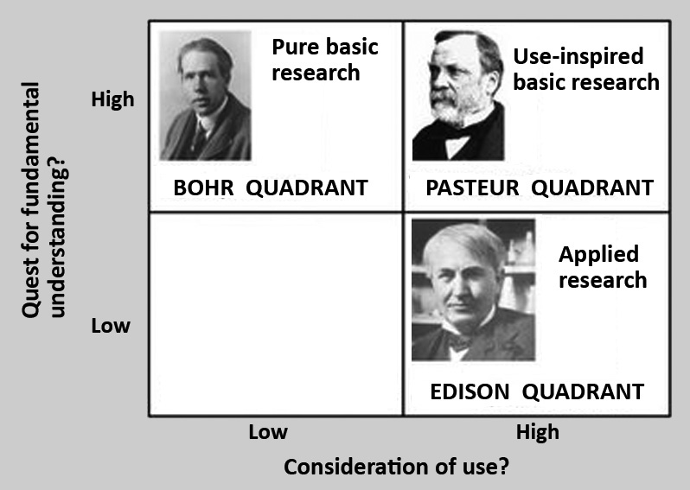
Pasteur’s quadrant
Pasteur's quadrant is a label given to a class of scientific research methods that both seek fundamental understanding of scientific problems, and, at the same time, seek to be eventually beneficial to society. Louis Pasteur's research is thought to exemplify this type of method, which bridges the gap between "basic“ and "applied" research. Courtesy Wikipedia.

Slide 9
Google’s management of innovation Organization @ Google
Applying the ‘rule of seven’ – to avoid micromanagement
A flat organization – facilitated by communications via technology
Functional organization – to avoid the creation of ‘silos’
Physical (office layout) arrangements – to create crowding and its benefits
Product/service people have a prominent role in presentations and decision making
Relationships are the focus not hierarchy
Use of OKR’s – management by objectives under a different guise

Slide 10
Google’s management of innovation Strategy @ Google
Platforms; not products or services, are the focus of strategic planning
Strategy presentations, at all levels including with the Board, are made by those who have a full knowledge of the inner workings of products and services – not some ‘management type’
Investment allocations are 70% for core products, 20% for emerging products, and 10% for the ‘unknown’
Somewhat limited use of financial projections – more emphasis on ‘faith’
No market research nor channel strategies
Strategic plans are employed to reinforce organizational alignment

Slide 11
Google’s management of innovation Board & senior management arrangements @ Google
Holding meetings at frequent intervals – to avoid repetition and at the same time instill a sense of urgency
Quarterly reviews for presentation to the Board and the dissemination of the plan update throughout Google
Meetings dominated by two questions; - What is the technical insight upon which new features will be built? - Data, and its use, not by ‘management types’ but by those who know the product/service intimately.
A bias for action – ‘smart creative’ will solve the problems as they arise

Slide 12
Google’s management of innovation Google’s thinking about Google
Google is great because of a combination of strategy, culture and an emphasis on hiring excellence.
More specifically, Googlers think ‘galactically’ and not, according to the authors, as most people think which is ‘incrementally’. ‘Googlers’ think big. The term ‘smart creative’ is used a lot in the book and its meaning is self-evident.
More subtly, it is alleged, is that Google has a culture which is well-established and well-understood and therefore becomes the ‘basis of everything’ the company does. Reference is made to the fact that culture ‘is the rails’ of the company and because of it the ‘risks of going off the rails are minimized’.
The idea of the founders was that the company was not about ‘maximizing the short-term value and marketability of their stock’. Rather, the belief was and is, that the culture of the founders would encourage the brightest individuals to join and that their talents would be ‘instrumental to long-term success’. Bright people, the ‘smart creatives’, could adjust for problems and changing circumstances as they arose.

Slide 13
Google’s management of innovation The role of engineers
Why is the issue of ‘engineers’ significant?
For Google overall and the founders in particular, the need is for employees who are steeped in coding and systems design – thus the need for engineers with this training.
Managing engineers is different. In Larry’s view, ‘traditional planning structures would not work’. Engineers need to be uniquely empowered – or so the story goes. One needs to understand deeply how the business works. That is the advantage and the inhibitor of progress which engineers bring to any organization.
‘Engineers’, at least most of them, don’t just get into a car to drive it, they have to understand how the engine works, brakes, etc. Understanding coding and systems design, its capabilities and its limitations is the key to understanding the high-tech business

Slide 14
A MODEL FOR THE SUCCESSFUL MANAGEMENT OF INNOVATION Six essential components
A generic model based on researching management practices of highly-innovative, idea-intensive companies

Slide 15
Your input to the model?
CIO – Corporate Innovation Online - with a view to sharing successful policies and management practices with interested readers, is in the process of developing a generic model for the management of innovation.
Which policies and management practices are common to highly-innovative companies?
Send your comments to pcwhite@corporateinnovationonline.com.

Slide 16
Booz&co. The 2013 Global Innovation Study
Booz&co’s report makes an insightful observation about innovation.
For the ninth year in a row, we have found no correlation between how much companies spend on R&D and their financial performance.
How companies spend their innovation dollars is much more important. Our studies have consistently shown that innovation investments in select capabilities, tools, talent, and culture which are tightly aligned with a business’s strategy are what drive sustained success.
These comments lead directly to CIO’s desire to develop a model for managing innovation, not based on any single-factor, but rather based on multiple factors. But which factors are the most important? There is no silver bullet!

Slide 17
Effective management of innovation
Culture
Financial and human resource management
Financial performance
Growth
Profit
Stock price
Earnings
P/E ratio
Strategy
CIO’s model is based on the hypothesis that effective management of innovation gives rise to better-than-average financial performance over the long term. In turn, innovation brings results in increased earnings and ultimately an increase in stock price, albeit impacted by the whims and vagaries of the market as a whole and the overall economy. The simplicity of the model belies the difficulty of doing it!

Slide 18
Six essential components for the successful management of innovation
CIO has researched a ‘basket’ of highly-innovative, idea-intensive companies and found that there are specific characteristics – i.e. policies and management practices common to most - which lead to innovation.
Our ‘basket’ includes; Starbucks, Deere & Co., GE, P&G and 3M along with practices drawn from over thirty other companies.
On the assumption that one learns more from mistakes than successes, we have also researched; RIM (now Blackberry), Massey-Ferguson, and HP.
1. Performance management
2. Communication
3. Reliability
4. Technology development
5. Culture
6. Strategy and organization

Slide 19
1. Performance management
Strong financial performance provides the company with a sense that its financial house is in order and that investment decisions, while satisfying clearly-stated and understood criteria, will be seriously considered for investment.
A system of managing human resources which aligns individuals with the corporate goals, measures individual and group performance, and provides fully transparent team-based rewards throughout the organization.

Slide 20
2. Communication
A focus on regular communication of corporate policies and management practices, appointments and matters impacting individuals and groups within the organization. Making people constantly aware of new developments about the ‘how’ of management.
A company which values broadly-based input into decision making and values speed but not over careful evaluation of opportunities and risks.
Cohesion and a commonly-held vision of the future is facilitated by meetings/gatherings of senior managers at key points in the development of the company.

Slide 21
3. Reliability
Delivering what the company says it will deliver to customers thus building a sense of trust between company and customer.
The delivery of reliable products – products which perform under all likely situations.

Slide 22
4. Technology development
A consistency in the company’s spending and approach to spending on R&D. People like to work for an organization which has a reputation for its ideas, its innovations. Spending is an indicator of this commitment.
Maintaining a watch on developments at the customer level and overall end-user and carefully noting the demographic and economic shifts which eventually impact product/service demand.
Continually monitoring competitor developments and understanding the competitive situation globally.
Investing in new products/services and less so in ‘legacy’ products.

Slide 23
5. Culture
Attributes of culture
3M is, when it comes to the management of innovation, outstanding and because of the practise noted below.
Tight centralized financial management with maximum decentralization and looseness throughout the organization.
A healthy regard to the impact of culture on acquisition practices – making culture an element of the criteria for any potential acquisition.
A healthy respect for traditions and even folklore.

Slide 24
6. Strategy and organization
Ensuring that industry knowledge and its complexity are well understood by a percentage of the Board of directors.
Suitable succession planning – a Board responsibility.
Continuity and longevity of senior management.
A Board and CEO perspective on both the short and long-term; achieving a balance in major decision making.
Making acquisitions which are essential to technology or market growth but where culture is an important part of the evaluation process.
At ease with adopting ideas from outside the organization through acquisitions or through mid-career hires.

Slide 25
Google’s contribution to a ‘model for the management of innovation’
Google’s approach to the management of innovation has contributed to the development of CIO’s model.
For a company to be successful it should have a set of policies and management practices which encourage innovation.
While the roles of senior management and the Board are important, it is the CEO who sets the tone and call the shots.
Effective management of innovation
Financial and human resource management
Financial performance
Growth
Profit
Stock price
Earnings
P/E ratio
Reliable products/services
Culture
Communications; intra-company
Technology investment
Strategy/organization

Slide 26
Companies reviewed most recently
CIO reports; provide insight into management of innovation and background information for investors
Starbucks
P&G
GE
DSM
Deere & Co.
http://www.corporateinnovationonline.com
Amazon
Massey-Ferguson Ltd.
Glencore (Xstrata)
HP
Koch Industries Ltd.
Blackberry (when it was RIM)
Apple versus RIM

Slide 27
End

